Slide 1

Deep Dive into Prompt Engineering & Content Safety

Slide 2

About me
Formerly:
Data Scientist in Defense, Healthcare industries
Arpita Parmar
Sr. Azure AI/ML Consultant at Microsoft

Slide 3
Today we’ll discuss
Prompt Engineering​
Responsible AI & Content Safety
Demo of Custom RAG Chatbot

Slide 4
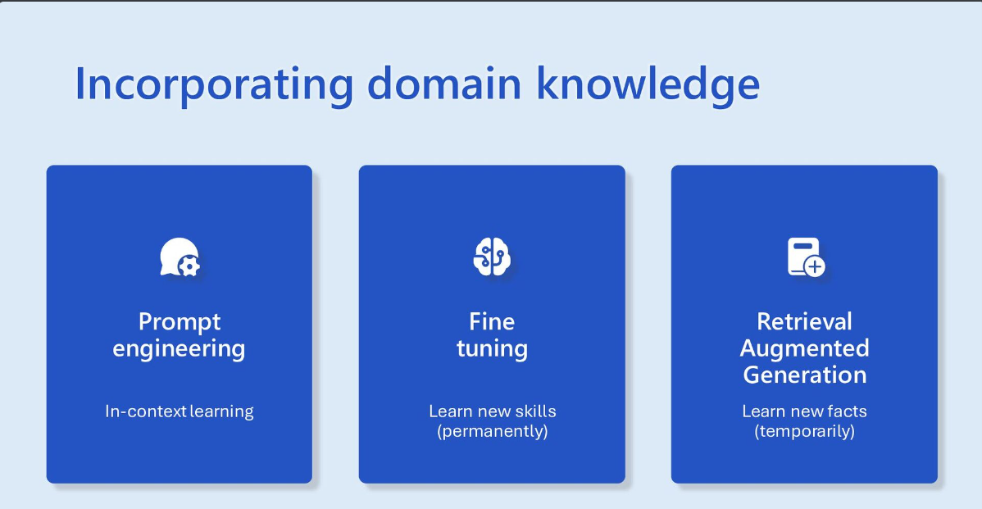

Slide 5



Architecture Pattern
RAG Architecture Components
RAG Architecture Components
Document Chunking
Azure Form Recognizer
Unstructured.IO
Document Understanding
Azure Open AI Embedding
Open-Source Embedding
Indexing
Azure Cognitive Search-vector Store
Search Techniques
Hybrid Search (Keyword + Vector)
Prompt Engineering
Custom stuffing of sources
Chain of Thought
Few Shot Prompting
Notes:
choices made in IA are well-suited for the current use case, but different use case patterns may require a different set of tools and techniques.

Slide 6

System Message (context setting)
Definition
Significance
Example
System messages are instructions or context-setting statements provided to guide the AI’s behavior in generating responses.
They influence the tone, style, or direction of the AI’s output.
Adding a system message like “You are an assistant for tax agency”

Slide 7

Mitigate Hallucination
Definition
Problem
Mitigation
Generation of fabricated or imaginative content by the language model, often beyond the scope of the input data or context.
Responses that are factually incorrect, misleading, or irrelevant to the given input.
Incorporation of chain of thought prompting to guide the model to maintain context and coherence.
Use of few shot prompting to provide specific examples, guiding the model to align with desired behavior.

Slide 8
Address Recency Bias
Definition
Problem
Example
Addressing Recency Bias
AI’s tendency to be influenced more by instructions at the end of the prompt.
Potential bias towards recent instructions, impacting response coherence.
A prompt ending with “Apple” may lead to bias towards the tech company, neglecting the fruit context.
Strategic rewriting and reordering of instructions mitigate bias, ensuring a more balanced influence on AI responses.

Slide 9

Randomness of Response
Explanation: Temperature is the parameter of LLM that controls the randomness of the AI’s output.
Temperature: Higher values increase randomness, while lower values make the output more deterministic.
Example: Adjusting temperature for creative writing vs. informative responses.
Customizable Randomness: We give users choice by allowing them to choose the degree of randomness in AI-generated responses.

Slide 10
Microsoft’s Responsible AI principles baked into Gen AI
Fairness
Reliability & Safety
Privacy & Security
Inclusiveness
Transparency
Accountability
AI systems should treat all people fairly.
AI systems should perform reliably and safely.
AI systems should be secure and respect privacy.
AI systems should empower everyone and engage people.
AI systems should be understandable.
People should be accountable for AI systems.
Notes:
The National Institute of Standards and Technology (NIST)

Slide 11
Example
Categories
How it works?
Example
Hate
Sexual
Self-Harm
Violence
Multi-Class, Multi-Severity, and Multi-Language
Returns 4 severity levels for each category (0,2,4,6)
Support blocklist
Input
Output
"Painfully twist his arm then punch him in the face jusqu’à ce qu’il perde connaissance"
Hate: 0
Sexual: 0
Self-Harm: 0
Violence: 4
Languages: English, Spanish, German, French, Japanese, Portuguese, Italian, Chinese

Slide 13
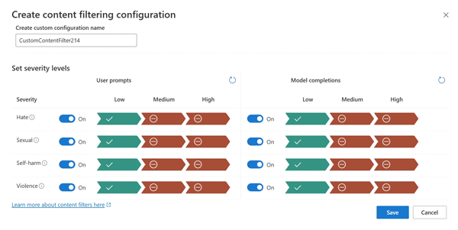
Configurable Azure OpenAI Content Filters
Severity | Configurable for prompts | Configurable for completions | Description
Low, medium, high | Yes | Yes | Strictest filtering configuration. Content detected at severity levels low, medium and high is filtered.
Medium, high | Yes | Yes | Default setting. Content detected at severity level low passes the filters, content at medium and high is filtered.
High | No* | No* | Content detected at severity levels low and medium passes the content filters. Only content at severity level high is filtered.
Notes:
The default content filtering configuration is set to filter at the severity threshold medium for all four content harms categories for both, prompts and completions.
Content that is detected at severity level medium or high is filtered, while content detected at severity level low passes the content filters. The configurability feature allows customers to adjust their content filtering settings for each content category for prompts and completions respectively to filter content at severity levels medium and low.
*For full content filtering control, including configuring content filters at severity level high only or turning the content filters off: Azure OpenAI Limited Access Review: Modified Content Filters and Abuse Monitoring

Slide 14
Q & A

